Slide 1
Quiz Game

Slide 2
Introduction/Objective (Problem Definition)
It is a C programming based quiz contest.
General knowledge and technical MCQ questions
For right answer the user get 5 points and if the answer is incorrect then no points is awarded.
The main objective of “Quiz Contest” is to facilitate a user friendly environment for all users and reduces the manual effort.

Slide 3
Platform Used
We have developed this project in C programming using VS CODE and Dev. C++ software which contains the GCC Compiler that can compile a C Program.
This project can be run on any platform that have the GCC Compiler, even in Command Prompt.
System Configuration used in this project are :
Windows 10
4GB Ram
500GB HDD
GCC version 11.2.0

Slide 4
Project Category
It is a Client server based application .
It means having user interaction and input output conversation
Front End
For building up this section File Handling in C programming has been used.
Back end
This section is supported by text file that act as both question set and answer set.

Slide 5
Requirement Analysis
There are 4 types of requirements for this project.
Functional Requirements
It must accommodate the new requirements specified by the end user.
It must be easy to use , serve almost all desire of user, and must have a scope of enhancement
Technical Requirement
Validation
Make Recommendation
Statistics
Report generation

Slide 6
Requirement Analysis (contd.)
Non – Functional Requirements
Performance Requirements
Safety Requirements
Security Requirements
Software Quality
Hardware Constraint
Software Constraint
Design Constraints

Slide 7
Project Feasibility
Economic Feasibility – If the benefit of the project is more than its cost then it is economically feasible.
Technical Feasibility – Whatever is there in the existing system over that what more u can provide in it if it’s under a given budget then it is technically feasible.
Legal Feasibility - If a System is 100% feasible then it is legally feasible
Operational Feasibility – when every member is able to operate the system equally hence it is ensured that every above mentioned feasibility are acceptable. It means operationally feasible.

Slide 8
Project Modules & Their Description
Question Bank – The question dataset has been made in a text file which consist of question based on general and technical knowledge.
Answer Set- The answer are written on a text file which has been used as an answer dataset.
Displaying question on screen- In this section the Question are being displayed in MCQ as the frontend process.
Points- Each question contains 5 points ,if the answer is correct 5 points will be awarded and if wrong then no points are awarded.
Scoreboard- After the user have answered all the question , the answer is being shown on the scoreboard

Slide 9
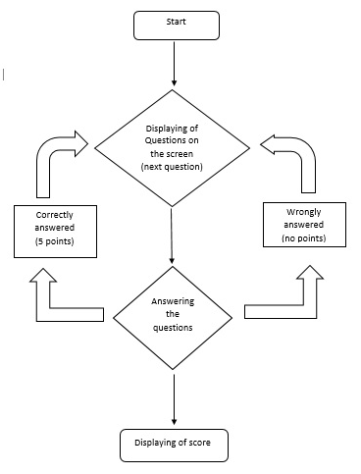
Flow Chart

Slide 10
Implementation of Security Mechanisms
System Security- It helps the operation system to protect deliberate or accidental damage from a defined threat.
Data Security – Protection of data from loss or destruction.
System integrity- Maintains safety against external threat.
Privacy – Defines the right of the user and protects the organization.
Confidentiality- It minimizes the possible invasion of privacy.
Security in software – It controls the system from failing.
Client Side – It ensure that valid data is entered.
Server side – It safes the system from failing and intimating.

Slide 11
Thank You

